Slide 1




Creative Commons Australia
Carpeted commons by Glutnix, http://www.flickr.com/photos/glutnix/2079709803/in/pool-ccswagcontest07 available under a Creative Commons Attribution 2.0 licence, http://creativecommons.org/licenses/by/2.0/deed.en
REGION
Asia-Pacific
VISION
To provide excellent support, advocacy and education to further the adoption of Creative Commons in Australia and the Asia-Pacific Region
Notes:
AFFILIATE HISTORY
From 2006-2014 QUT had an MOU as the sole Australian affiliate, under the leadership of Professor Brian Fitzgerald and Professor Tom Cochrane.
With a strong desire to see the momentum of adoption of open content licensing increase and drawing on the depth of expertise and commitment to the vision of Creative Commons in Australia we are delighted to launch the new CC australia affiliate structure
Joining QUT is the Australian Governments Open Access and Licensing Framework and the National Copyright Unit.
These are our priority goals…

Slide 2

Australian Governments’ Open Access and Licensing Programme (AusGOAL) - Lead Affiliate for Publicly Funded Information
Carpeted commons by Glutnix, http://www.flickr.com/photos/glutnix/2079709803/in/pool-ccswagcontest07 available under a Creative Commons Attribution 2.0 licence, http://creativecommons.org/licenses/by/2.0/deed.en
Affiliate Lead:
Baden Appleyard
b.appleyard@ausgoal.gov.au
www.ausgoal.gov.au/
Priority Goals
Notes:
AusGOAL
Implementing the AusGOAL Programme across all levels of government and publicly funded research, including, but not limited to:
development of tools to implement CC (eg. Microsoft Office Add-In and work with other software companies and productivity tool providers),
AusGOAL Practitioners Networks,
copyright and CC training and training materials, (AusGOAL endorsed the CC v4.0 Licences in February 2014)
provide policy and legal advice,
support the NCU to implement ‘open’ in education,
provide high level guidance and advice to government and the publicly funded research sector on all aspects of open access and licensing,
perform any other role and activity consistent with the AusGOAL Board’s instructions.

Slide 3
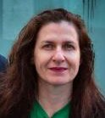
National Copyright Unit (NCU) - Lead Affiliate for Education
Carpeted commons by Glutnix, http://www.flickr.com/photos/glutnix/2079709803/in/pool-ccswagcontest07 available under a Creative Commons Attribution 2.0 licence, http://creativecommons.org/licenses/by/2.0/deed.en
Affiliate lead:
Delia Browne
delia.browne@det.nsw.edu.au
http://www.smartcopying.edu.au/
Priority Goals
Notes:
Implementation of AusGOAL framework in Departments of Education and related agencies
Develop OER Policy Adoption brief for Australian Government School sector to be approved by Copyright Advisory Group and then AEEYSOC.
Update the Guide to Creative Commons for educators and making it available from www.smartcopying.edu.au and others ( such as AusGOAL and QUT and CC HQ)
Provide legal and policy advice to Australian school and TAFE sector on CC licences and OER
Support AusGOAL including liaising with government where appropriate re AusGOAL compliance and why education supports and needs AusGOAL
Deliver a series of workshops to Departments of Education, Catholic Education Offices and Associations of Independent Schools e learning and curriculum areas re how to find OER and creating OER for the Australian schools sector
Deliver workshops, seminars and presentations to Australian Schools and TAFEs.
Continuing to advise and work with ESA, ACARA and AITSIL to promote AusGOAL and CC/OER
Faciliate and lead Copyright4Educators course on P2PU- www.p2pu.org and develop an Australian version of CC for Educators.
Liaise where appropriate with tertiary institutions and RTOs re adoption of CC and OER
Encourage the adoption of Version 4.0 to the education sector
Continue updating our CC/OER section of www.smartcopying.edu.au

Slide 4
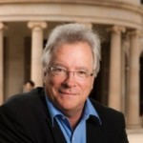
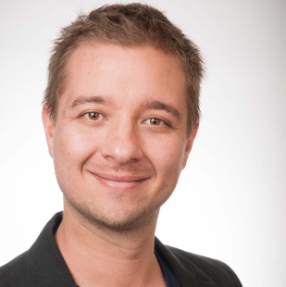
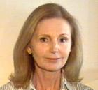
Creative Commons Australia Queensland University of Technology (QUT) - Lead Affiliate for Creative Sector, GLAM, Private Sector and Legal Lead
Carpeted commons by Glutnix, http://www.flickr.com/photos/glutnix/2079709803/in/pool-ccswagcontest07 available under a Creative Commons Attribution 2.0 licence, http://creativecommons.org/licenses/by/2.0/deed.en
Affiliate lead:
Tom Cochrane
t.cochrane@qut.edu.au
Affiliate lead:
Nicolas Suzor
n.suzor@qut.edu.au
Project Manager:
Nerida Quatermass n.quatermass@qut.edu.au
Priority Goals
Education, community building, and outreach
Advocacy
Research
Notes:
Education, community building, and outreach
Review and update the CC Australia fact sheets produced and maintained by QUT
Create new copyright information fact sheets (6 x sector specific creators and users; 6 x limitations and exceptions; 5 x general information)
Re-establish connections with adopters in private sector & GLAM
Work with Universities to develop best practices for open licensing (OA, OER, Free Software)
Provide support for Open Access to Scholarly Communications (particularly via University library sector)
Re-design website (audit existing information; analytics and visitor flow optimisation)
Develop and implement social media and comms strategy (Bledsoe)
Establish workflows and source updates from community for steady communications through distinct channels
Respond to public enquiries; directing to appropriate contacts to respond.
Advocacy
Continue to support 'Fair Use alliance' & engage as appropriate
Continue engaging with advocacy and support for Open Access, Open Data, OER as appropriate
Continue advocacy in removing barriers between collecting societies and CC (particularly APRA/AMCOS/PPCA) - excluding government or education sector arrangements with Collecting Societies.
Research
Develop updated case studies from existing adopters
Continue research on open business models and mechanisms to support open production
Work towards development of an empirical model for policy analysis that enables counterfactual testing and optimisation of different incentives across different industries.

Slide 5
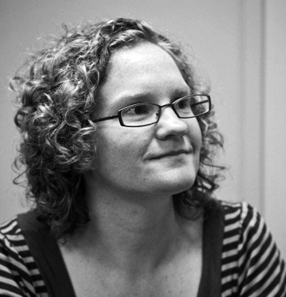

Creative Commons Australia
Carpeted commons by Glutnix, http://www.flickr.com/photos/glutnix/2079709803/in/pool-ccswagcontest07 available under a Creative Commons Attribution 2.0 licence, http://creativecommons.org/licenses/by/2.0/deed.en
And wonderful volunteers:
Jess Coates- Global Network Coordinator and Asia-Pacific Regional Coordinator Creative Commons
Elliott Bledsoe-
QUT students and external volunteers: Nat Cameron, Shannon Miller, Ray Dowling, Rex Cho, Jessica Price, Jessica Pietsch

Slide 6

Appeal
Carpeted commons by Glutnix, http://www.flickr.com/photos/glutnix/2079709803/in/pool-ccswagcontest07 available under a Creative Commons Attribution 2.0 licence, http://creativecommons.org/licenses/by/2.0/deed.en
https://donate.creativecommons.org/
Notes:
This presents CC au with a fantastic opportunity for growth, outreach and community engagement

Slide 7
Fireworks *
Carpeted commons by Glutnix, http://www.flickr.com/photos/glutnix/2079709803/in/pool-ccswagcontest07 available under a Creative Commons Attribution 2.0 licence, http://creativecommons.org/licenses/by/2.0/deed.en
World largest shell by hiramu55ocaboca on https://www.youtube.com/watch?v=AUPPBNDCFk4&feature=youtu.be
Notes:
This presents CC au with a fantastic opportunity for growth, outreach and community engagement

